Slide 1
Year 4 Curriculum Evening
Miss McCrea

Slide 2
Long Term Plan
TERM |  | AUTUMN 1 | AUTUMN 2 | SPRING 1 | SPRING 2 | SUMMER 1 | SUMMER 2
KEY QUESTION |  | ‘Does Chocolate Grow on Trees?’ | ‘Does Chocolate Grow on Trees?’ | ‘Why did the Vikings Invade Britain?’ | ‘Why did the Vikings Invade Britain?’ | ‘Who Lives in The Rainforest?’ | ‘Who Lives in The Rainforest?’
ENGLISH | Reading texts | The Iron Man | Ice Palace | Varjak Paw | The Night Bus | The Pebble in My Pocket – A history of our earth | The Fib
 | Writing | Recount (diary entry) Newspaper report Biography – chronological report. | Non-chronological report Character descriptions. Narrative. Poetry – free verse | Letter to persuade Narrative Poetry – acrostic | Non-chronological report Narrative - Creating setting Script writing | Explanation - Factfile Narrative Poetry | Instruction text Narrative Poetry – Poems to perform
MATHS |  | Place Value Addition and subtraction Multiplication and division Time | Fractions and Decimals Measures: data Subtraction Multiplication and Division | Place value; addition and subtraction Multiplication and division Fractions 2D shapes Mental calculation | Addition and subtraction Place Value Multiplication and division Time Length | Place Value and decimals. Fractions Multiplication and division. Measurement | Addition and subtraction and problem solving Multiplication and division. Geometry Measurement and statistics

Slide 3
SCIENCE | Sound | Living things and their habitats | Electricity | States of matter | Animals, including humans
HISTORY & GEOGRAPHY | The Mayans Using globes and atlases |  | The Anglo-Saxons The Water Cycle | The Vikings | The Equator The Rainforests | South America

Slide 4
Reading

Slide 5
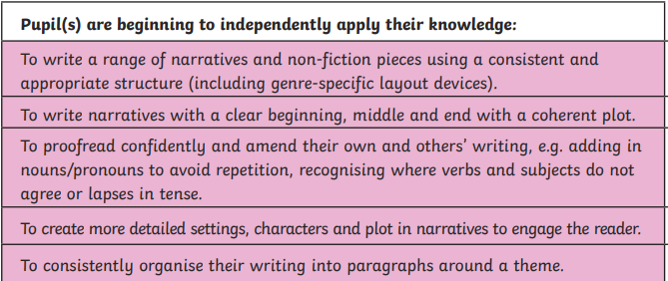
Writing

Slide 6
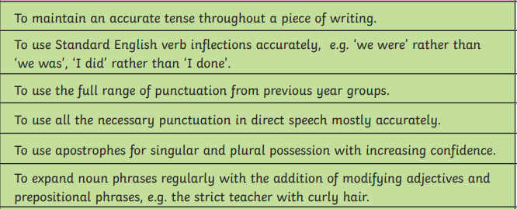

Slide 7
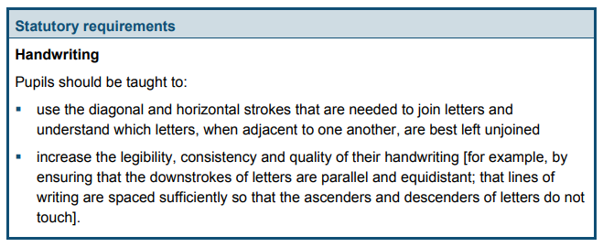
Handwriting It is expected that children in Year 4 use cursive handwriting consistently in their work.

Slide 8
Maths

Slide 10
Times Tables
In June, Year 4 children take part in the Multiplication Check set by the Department for Education. It tests all times tables up to 12 x 12.

Slide 11
PE
During the Autumn term, children will need their PE kit every Wednesday.
We advise that they bring it in at the start of the half term and take it home at the end of the half term.
PE kit consists of a white t-shirt, black shorts and black trainers.
Swimming takes place on a Thursday.

Slide 12
Homework and Reading Books
Homework is due in the last week of the half term.
Reading
Spellings
Maths and times tables
Project
Active learn

